Slide 1


www.tarahtech.com

Slide 2


A primer on Analytics and AI
Srinivas Padmanabhuni

Slide 3



Slide 4

Why Analytics?
•Decision making is critical to success of Businesses.
• Quality of decision making is hence important for businesses
• Usually several kinds of biases play out in decision making
• Important to understand that there are several ways of avoiding biases in decision making
• Analytics Technology brings objectivity to decision making

Slide 5
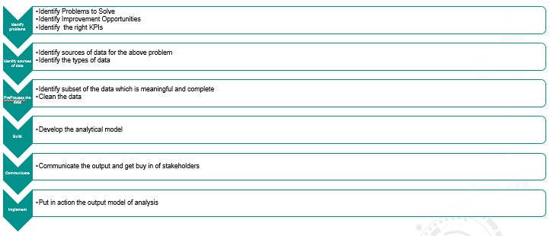
Analytics Process

Slide 6
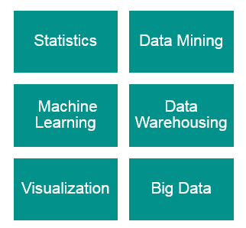
Analytics Technologies (Representative)

Slide 7


Slide 8
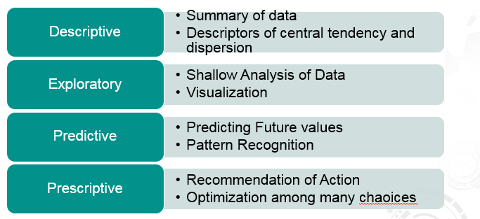
Different Kinds of Analytics

Slide 9
Descriptive Analytics
First Step in Analytics
Answers the question: What happened?
Summary of the historical data
Measures of Central Tendency
  Mean , Median, Mode
Measures of Dispersion
  Standard Deviation, Variance, Kurtosis

Slide 10
Exploratory Analytics
Second Step in Analytics
Opposite to Confirmatory model
Commonly uses different visualizations
Line Plots for Continuous Variables
Histogram Plots for Discrete Variables
Analyzing data for outliers
Box Plots
Reducing Dimensions in Data

Slide 11
Predictive Analytics
Analytics for Future Prediction: what will happen?
Uses following techniques
Data Mining
Machine Learning
Predictive Modeling
Time Series Models
Building Models and Validate Models
Modeling of input variables and likelihood of outcomes

Slide 12
Prescriptive Analytics
The ACTION part of all the previous kinds of analytics is referred to as “Prescriptive Analytics” – what can be done now?
Choosing the best possible alternative with the background descriptive, inferential, exploratory and predictive models
Lends itself to an optimization problem
Also often termed as Multi Criteria Decision Making
Expert Systems and Decision Support Systems can be built using predictive techniques to suggest which ACTION is best for the targeted situation

Slide 13
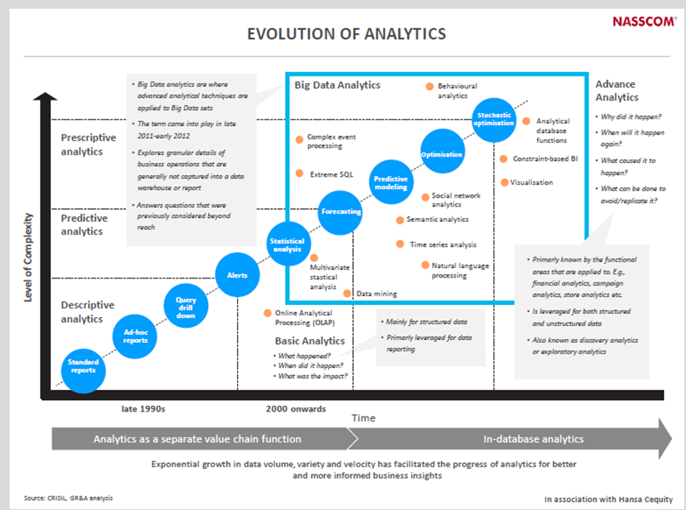
Analytics Maturity in India
•Source: Nasscom 2015 report : Application,Innovation,And Maturity of Indian Analytics

Slide 14
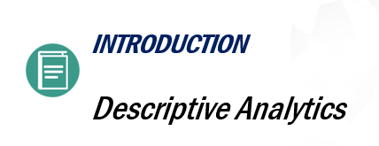

Slide 15
Descriptive Analytics
First Step in Analytics
Answers the question: What happened?
Summary of the historical data
Measures of Central Tendency
  Mean , Median, Mode
Measures of Dispersion
  Standard Deviation, Variance, Kurtosis

Slide 16
Measures of central tendency
Mean – average of the data across the stream
Median – Mid point of the data across the stream
Percentile –
Quartile –
  First Quartile is the 25th percentile
  Second Quartile is the median
  Third Quartile is the 75th Percentile

Slide 17
Measures of dispersion
Absolute Standard Deviation
Variance – Measure of spread of distance from mean
InterQuartile Distance
  Distance between First and Third Quartile
IQR is a good measure for determining outliers
Range is a good measure of the difference between large and small data
Variance to Mean Ratio

Slide 18
SKEWNESS
•Skewness formula is given by
•Skewness = (mean-mode)/Standard deviation
•The skewness provides the data values diverging from the mean values of the data set
•The skewness can be used to estimate the symmetry and divergence of the data set
•The ideal normal distribution function skewness and kurtosis should be zero

Slide 19
KURTOSIS
•Kurtosis is a parameter that depicts the state of an arbitrary variable's probability distribution
•The sharper peak in the center of the distribution provides larger kurtosis value than the normal distribution
•Like the skewness, Kurtosis also depicts three states as follows
•If kurtosis value is zero,then type of distribution is known to be meso kurtic
•If kurtosis value is negative, then type of distribution is known to be platy kurtic
•If kurtosis value is positive, then type of distribution is known to be lepto kurtic

Slide 20
Use Cases of Descriptive Analytics
Let us assume we want to get an idea of average rainfall in different parts of India
We will first get raw data from weather dept
Then we will slice it by region
Then we will compute descriptive analytics of local data in a region for a specified period of time

Slide 21


Slide 22

LEARNING OBJECTIVES:
At the end of this lesson, you will be able to :
O Understand exploratory analytics
O What steps are typically used in exploratory
Analytics
Cleanse Data
Treat missing values
Treat outliers and errors
Reduce Dimensions of Data
O Use case of exploratory analytics

Slide 23
Exploratory Analytics
Second Step in Analytics
Less of Formal Models
Typical tasks include
  Data visualization to get a big picture
  Correlation Analysis
  Dealing with Missing Values
  Treating Anomalies and Outliers
  Reducing Dimensions

Slide 24
Data Visualization for Exploratory Analysis
Univariate Plots
  Line Plots
  Histograms
  Box Plots
Bivariate Plots
  Scatter Plots
  Correlograms
Multivariate Plots
  Mesh Plots
  3D plots

Slide 25
Data Imputation
To Treat Missing or Null Values
Different Approaches
Data Imputation by Measures of Central Tendency
  Imputation by Mean of Column
  Imputation by Median of Column
  Imputation by Mode of Columns (Categorical Variables)
Nearest Neighbour Methods
  KNN Based Imputation
Regression based approach
Hot Deck approach

Slide 26
Anomaly or Outlier Detection
Identification of items, observations which do not follow expected pattern or are dissimilar to other items in a dataset
Examples: Fraud Detection, Hack Attacks
Techniques:
  Descriptive Analytics driven
  Clustering Based Approaches
  Distance based approaches
  Classification based approaches

Slide 27
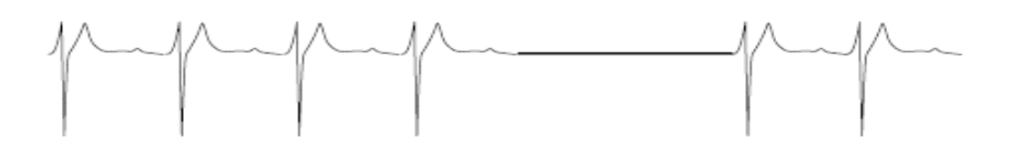
Types of anomalies
Point anomalies - An individual data instance is anomalous w.r.t. the data
Contextual Anomaly – Individual data instance anomalous in a context, also known as conditional anomaly
A collection of related data instances is anomalous

Slide 28

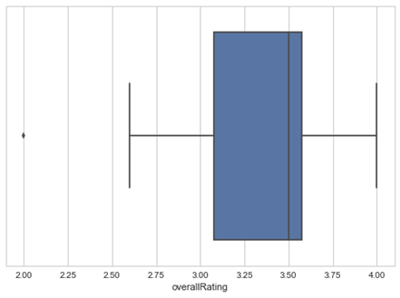
Example Anomaly Detection Technique
Using Descriptive Analytics and visualization of Box Plot
Formula
An outlier if:
  Point > Q3 + 1.5 * IQR OR
  Point < Q1 – 1.5* IQR

Slide 29
Dimensionality Reduction
Univariate Analysis to Drop Variables
  Too Uniform
  Too low density
Bivariate Correlogram Analysis
  Remove one among a pair of highly correlated input variable pair
Principal Component Analysis
  An idea to reduce overall dimensions while keeping the overall coverage
  Works with far fewer dimensions than original dimensions

Slide 30
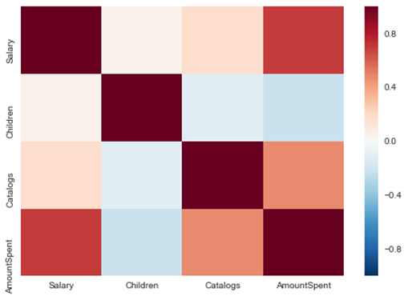
Bivariate Correlogram Analysis
•Pairwise analysing input variables for correlation

Slide 31
What is PCA
PCA stands for Principal Component Analysis .
PCA is extraction of important variables from a large number of variables in a Data Set.
PCA extracts low dimensional set of features from a high dimensional data set, with a motive to capture as much information as possible
Useful only when the number of attributes is 3 or greater than that

Slide 32
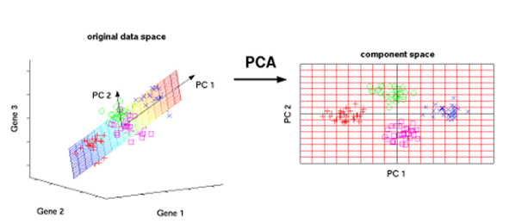
PCA Example
As an example if there are 30 attributes in a data set,
it requires 30 * 29 (30-1)/2
plots i.e. more than 400 plots to analyze the
relationship between the attributes
PCA helps us minimize the number of attributes,
making it is easier for the analysis.

Slide 33
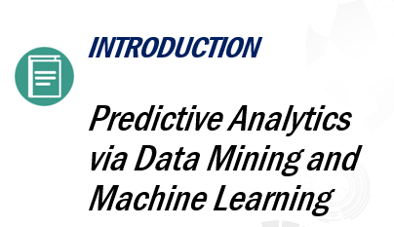

Slide 34
Data Mining vs Machine Learning
Large Overlap
Typically core set of techniques same
Data Mining and Machine Learning though have separate roots
But a unifying model can be obtained by considering data mining as one kind of machine learning
Data Mining largely refers to pattern extraction from large data

Slide 35
Machine Learning Defined
A computer program is said to learn from experience if its performance at tasks improves with experience .
-Can be Unsupervised, or Supervised or Reinforcement

Slide 36
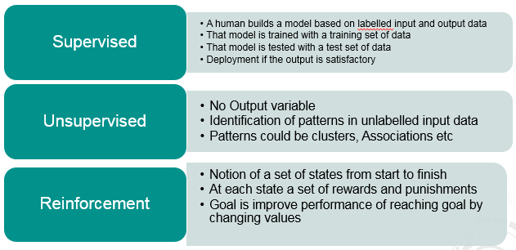
Types of Machine Learning

Slide 37
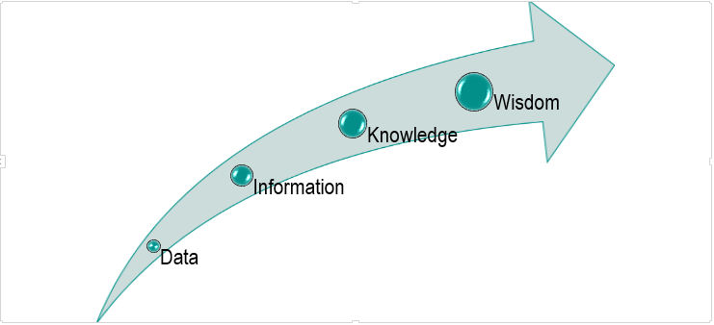
The path of pursuit

Slide 38
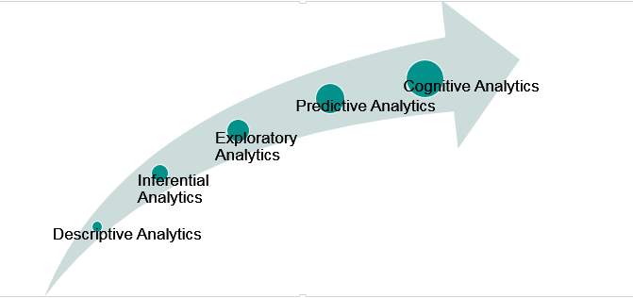
ML as a continuum of analytics

Slide 39
Fine Grained ML Types
Reinforcement Learning
Supervised Learning
  Classification
  Regression
Unsupervised Learning
  Clustering
  Association Rule Mining
  Feature Extraction
  Anomaly Detection

Slide 40
Reinforcement Learning
Reinforcement Learning need not have past data
Notion of a set of states from start to finish
At each state a set of rewards and punishments
Goal is improve performance of reaching goal by changing values
Example Applications include games, dynamic path planning for robots etc

Slide 41
Supervised Classification
In classification, the target variable is categorical.
  For a new input, you have to put it in one of the categories into which it will fit
  Example : Classify Sentiments from Tweets into Neutral, Positive and Negative.
  Example: Classifying patient profiles as risky or safe based on historical data
Simplest: binary classification
Given: a set of m examples (xi,yi) i = 1,2…m sampled from some distribution D, where xiÎRn and yiÎ{-1,+1}
Find: a function f f: Rn -> {-1,+1} which classifies ‘well’ examples xj sampled from D.

Slide 42
Supervised Regression
In regression, the target variable is continuous.
  For a new input you have to predict the potential value of the output
  Example: Derive the model for Fuel Consumption based on model, time of day, age of vehicle etc.
  Example: Derive the potential future price of a stock based on historical analysis of data deriving from features like stock, quantity, news related to stock etc.

Slide 43
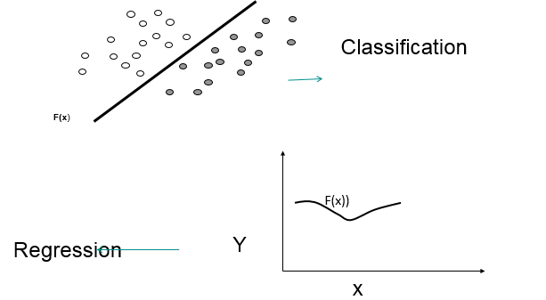
Classification versus Regression

Slide 44
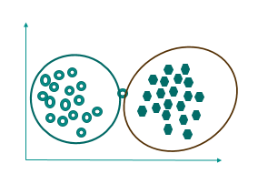
Unsupervised Clustering
No Output Class
Data point is not labeled
Group the items which are close to each other
Identify structure or pattern in data
Example: Identify customers with similar buying habits

Slide 45
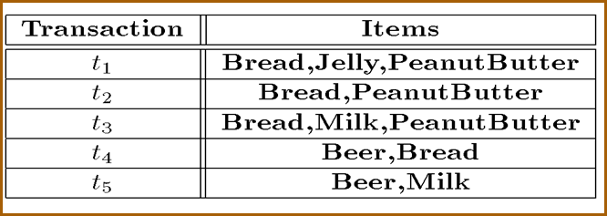
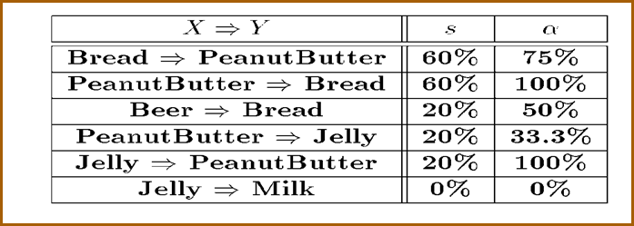
Unsupervised Association Rule Mining
No Output Class
Items Bought together Most Frequently
Identify items occurring together in market baskets or shopping carts
Example: Identify items to cross sell with market basket analysis

Slide 46
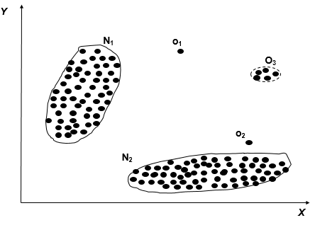
Anomaly Detection
Often data points exist which do not follow usual behaviour as rest of data
Identifying such anomalies/outliers is a key ML task
Example: Fraud Detection

Slide 47
Use Cases of Predictive Analytics and Machine Learning
Sales Performance Analysis
Customer Segmentation
Competitor Analysis
Marketing Mix Optimization
Sales Pipeline Analysis
Campaign Analysis
Talent Analytics
Supply Chain Analytics
Customer Life Cycle Management
Corporate Performance Management

Slide 48
Granular Machine Learning Tasks
Understand written texts, say old classics
Recognizing speech as in Automation of Call Centre
Separating HeadNotes in Legal Documents
Recognizing an animal in Youtube
Finding obstacles and avoiding it in Robots
Pinpoint Breast cancer occurrence to guide Doctors
Understand Dementia Patients and Guiding them to the context
Generate Art, Music, Literature
Robotics (Manufacturing, High Tech)
Autonomous vehicles (Transportation, Logistics)
Speech recognition (Financial Services, BPO)
Language recognition (Publishing, Media, Healthcare, Social Media)

Slide 49

Let us check our understanding
Which of the following is not a predictive analytics use case
1.Find best route to office
2.Predicting next years profit
3.Which customer segment buys what
4.Cancer is malignant or benign

Slide 50


Slide 51
Prescriptive Analytics
The ACTION part of all the previous kinds of analytics is referred to as “Prescriptive Analytics” – what can be done now?
Choosing the best possible alternative with the background descriptive, inferential, exploratory and predictive models
Lends itself to an optimization problem
Also often termed as Multi Criteria Decision Making
Expert Systems and Decision Support Systems can be built using predictive techniques to suggest which ACTION is best for the targeted situation

Slide 52
Prescriptive analytics techniques
Rule based systems aided by Predictive Analytics tools
Expert Systems and Decision Support Systems can be built using predictive techniques to suggest which ACTION is best for the targeted situation
Optimization techniques with tools like CPLEX could range from simplex kind of simple optimization techniques to complex constraint programming kind of scenarios

Slide 53
Prescriptive analytics use cases
Business strategy
  A CEO can decide upon either expanding to a new country or expand business in a country based on prescriptive analytics of strategic alternatives
Agriculture
  Via right kind of sensor data, key parameters of soil, moisture etc can be measured and the right strategy for crops can be prescribed apt for the condition
Smart Traffic
  By use of dynamic real time traffic information planning of alternative routes is possible in form of prescriptions

Slide 54
Analytics Life Cycle

Slide 55
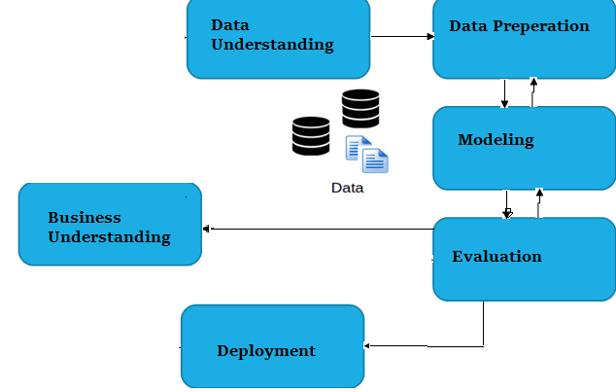
Data Science Life Cycle – CRISP DM
CRISP-DM Model(Cross Industry Standard Process for Data Mining) was conceived in late 1996
Different steps are as below:
      Business Understanding
      Data Understanding
      Data Preparation
      Modeling
      Evaluation
      Deployment
Source: http://www.sv-europe.com/crisp-dm-methodology/
Notes:
55

Slide 56
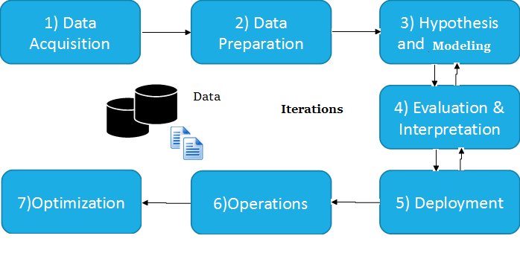
Data Science Life Cycle – CRISP DM Method
The typical Data Science Life Cycle Model have following steps
Data acquisition
Data Understanding
Data Preparation
Hypothesis and modeling
Evaluation and Interpretation
Deployment
Notes:
56

Slide 57


Slide 58
Thank you

